Slide 1
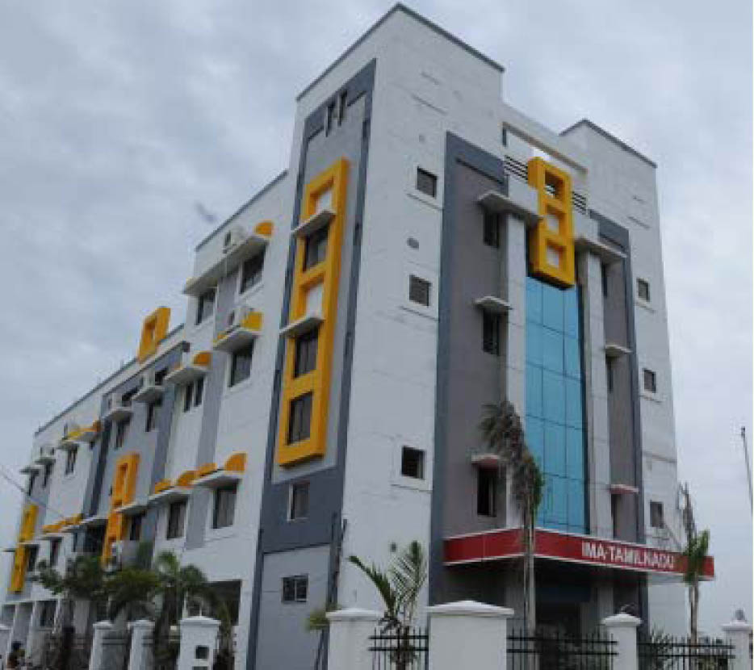
IMA TNSB GUEST HOUSE

Slide 2
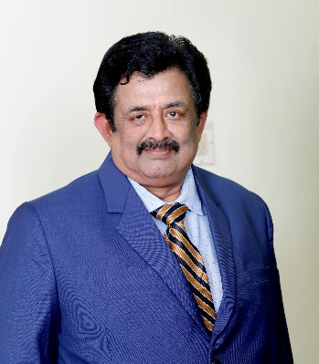
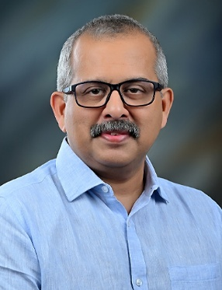
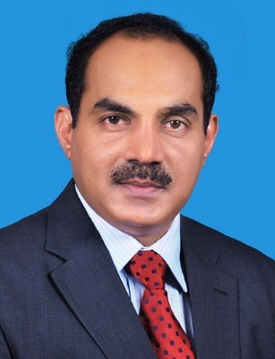
INDIAN MEDICAL ASSOCIATION TAMILNADU STATE BRANCH
Dr. B. SRIDHAR
State President
Dr. M. THIRAVIAM MOHAN
State Secretary
Dr. D. SOLOMON JEYA
State Finance Secretary

Slide 3
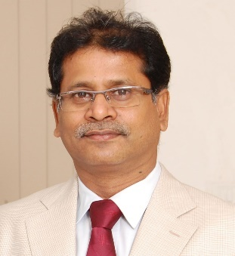
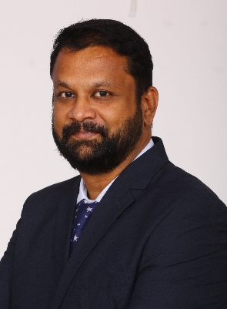
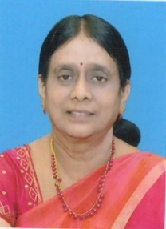
IMA TNSB – GUEST HOUSE
Dr. S. KASI
Chairman
Dr. AMUTHA KARUNANIDHI
Co-Chairman
Dr. C. NANDA KUMAR
Secretary

Slide 4


Slide 5
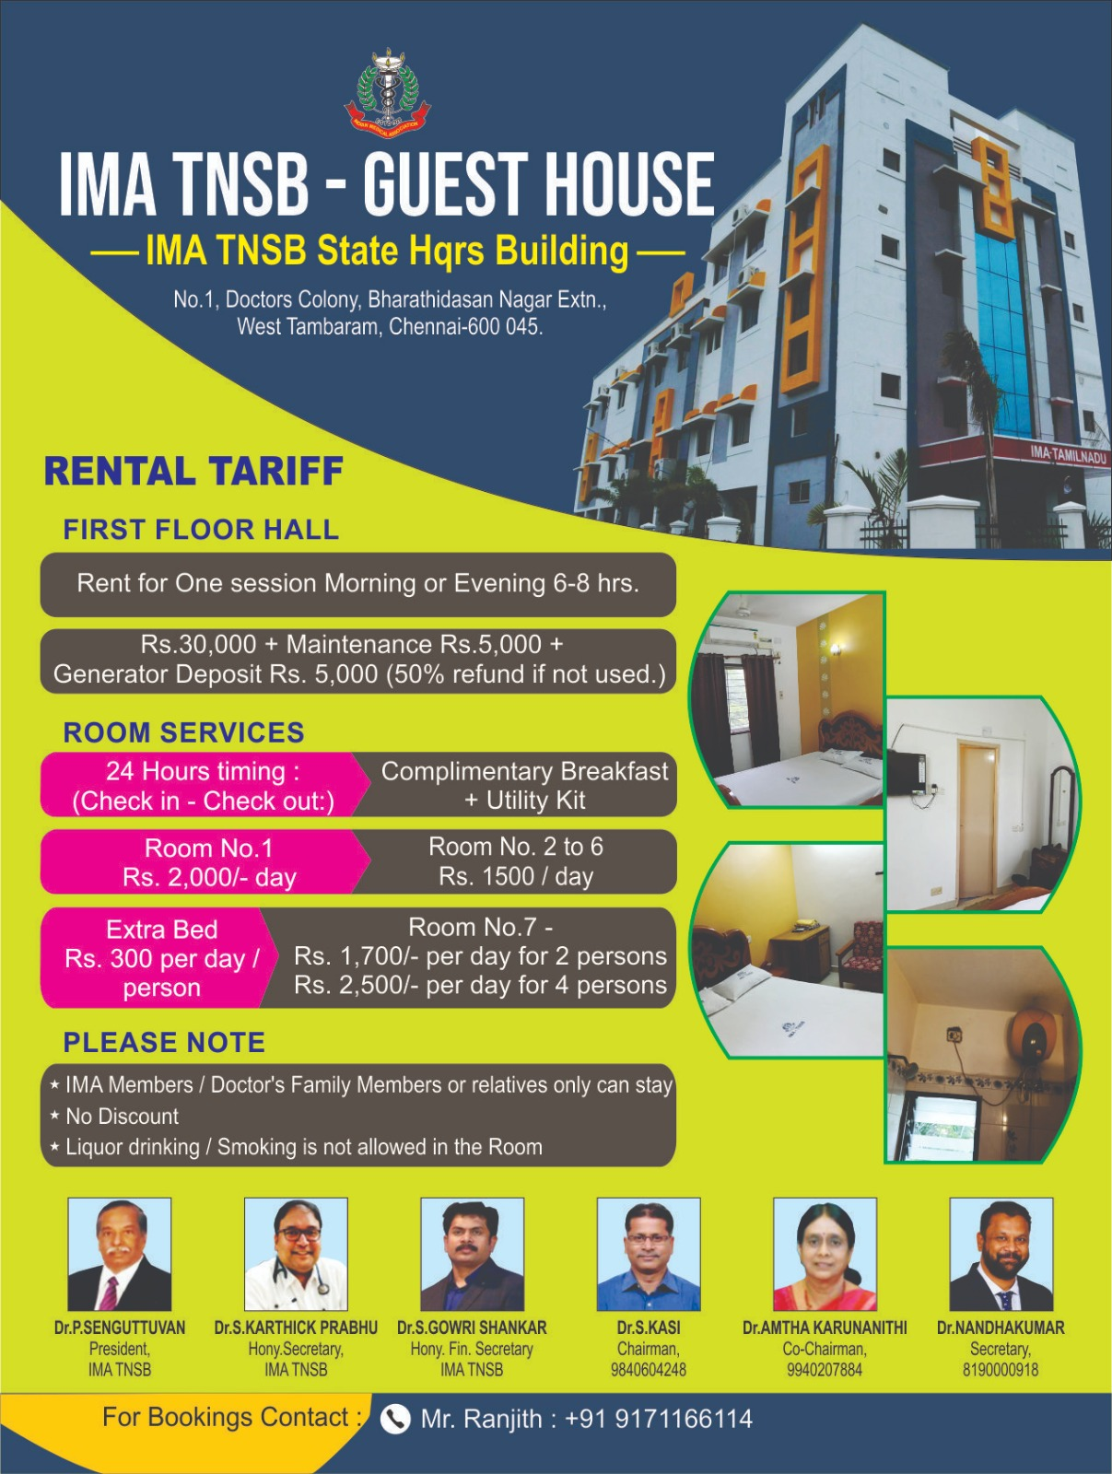

Slide 6
HALL RENTAL TARIFF

Slide 7
ROOM TARIFF

Slide 8
FOR BOOKINGS – KINDLY CONTACT / WHATSAPP / e.mail
90871 80123 / 81900 00918
secretary@imatnsb-hqgh.com

Slide 9
Online booking – Demo on process
https://www.imatnsb-hqgh.com/

Slide 10


